Slide 1
Fractions
EQ: How do I use the CUBES method to solve fraction problems?

Slide 2
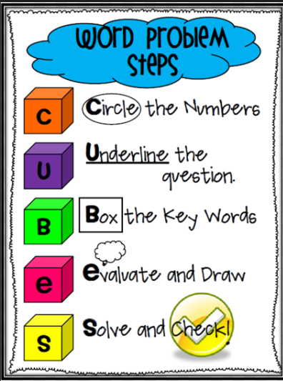
24
7
30
Topic: Fractions
Date: /07/2018
EQ – How do I use the CUBES method to solve fraction words questions?

Slide 3
24
7
30
Topic: Fractions
Date: /07/2018
EQ – How do I use the CUBES method to solve fraction words questions?
A donkey eats $\frac{3}{4}$a hay bale a week. How many hay bales does he eat in 24 days?
18 bales

Slide 4
24
7
30
Topic: Fractions
Date: /07/2018
EQ – How do I use the CUBES method to solve fraction words questions?
There is ³/₈ of a pizza in one box and ¹/₄ of a pizza in another box. How much do you have altogether?
5/8

Slide 5
24
7
30
Topic: Fractions
Date: /07/2018
EQ – How do I use the CUBES method to solve fraction words questions?
My working out | Explanation of my steps to show my partner
Adding fractions

Slide 6
24
7
30
Topic: Fractions
Date: /07/2018
EQ – How do I use the CUBES method to solve fraction words questions?
Adding fractions
Right hand side or Student 1 to complete this question:
You give ¹/₃ of box of brownies to Ella and ¹/₆ of the pan of brownies to Nick. How much of the box of brownies did you give away?
Left hand side student to complete this question:
Tom completed 11/ 12 of Saturday's crossword and 11 /12 of Thursday's crossword. Tom also did 2/ 3 of the jumble puzzle. In total, what fraction of these crosswords did Tom finish?
Quick you have 2 mins before you teach your partner how to do your question

Slide 7
24
7
30
Topic: Fractions
Date: /07/2018
EQ – How do I use the CUBES method to solve fraction words questions?
ANSWERS Adding fractions
Right hand side or Student 1 to complete this question:
½ or 3/6
Left hand side student to complete this question:
1 and 5/6 puzzles
Quick you have 2 mins before you teach your partner how to do your question

Slide 8
24
7
30
Topic: Fractions
Date: /07/2018
EQ – How do I use the CUBES method to solve fraction words questions?
Subtracting fractions
Right hand side or Student 1 to complete this question:
A jug contains ³/₄ litre of orange juice. After you pour ⁵/₈ of a litre into a glass, how much is left in the jug?
Left hand side student to complete this question:
Amy ran ²/₃ of a marathon. Beth ran ⁵/₆ of a marathon. Who ran farther? How much farther?
Quick you have 2 mins before you teach your partner how to do your question

Slide 9
24
7
30
Topic: Fractions
Date: /07/2018
EQ – How do I use the CUBES method to solve fraction words questions?
ANSWERS Subtracting fractions
Right hand side or Student 1 to complete this question:
1/8
Left hand side student to complete this question:
Amy ran 4/6 so Beth ran further by 1/6.
Quick you have 2 mins before you teach your partner how to do your question

Slide 10
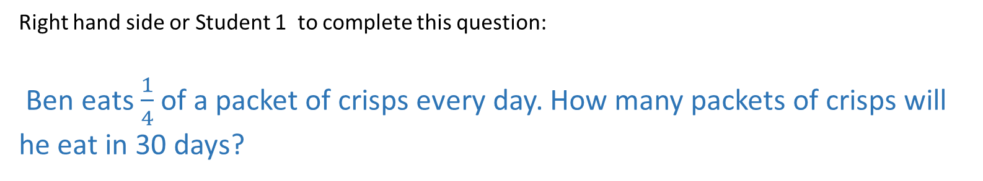
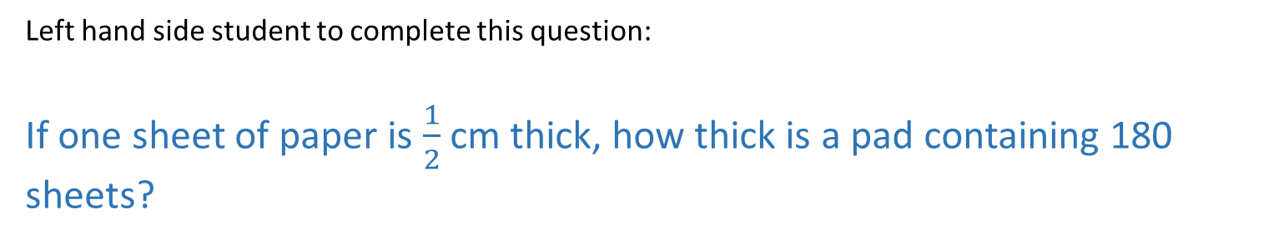
24
7
30
Topic: Fractions
Date: /07/2018
EQ – How do I use the CUBES method to solve fraction words questions?
Multiplying fractions
Right hand side or Student 1 to complete this question:
Ben eats $\frac{1}{4}$ of a packet of crisps every day. How many packets of crisps will he eat in 30 days?
Left hand side student to complete this question:
If one sheet of paper is $\frac{1}{2}$ cm thick, how thick is a pad containing 180 sheets?
Quick you have 2 mins before you teach your partner how to do your question

Slide 11
24
7
30
Topic: Fractions
Date: /07/2018
EQ – How do I use the CUBES method to solve fraction words questions?
ANSWERS Multiplying fractions
Right hand side or Student 1 to complete this question:
7.5 Packets crisps
Left hand side student to complete this question:
90 cm thick
Quick you have 2 mins before you teach your partner how to do your question

Slide 12
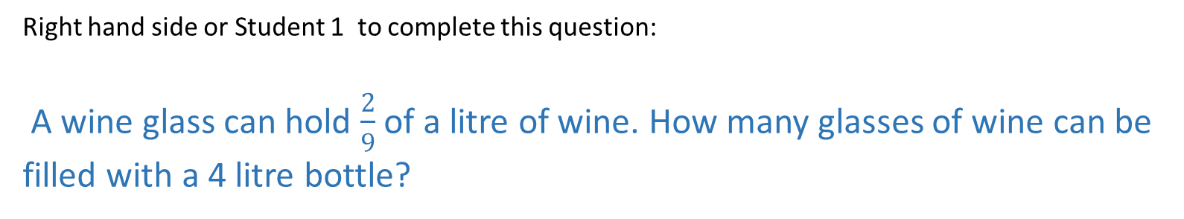
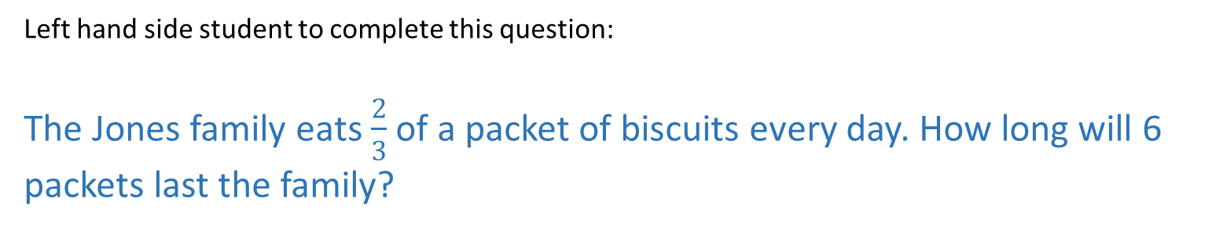
24
7
30
Topic: Fractions
Date: /07/2018
EQ – How do I use the CUBES method to solve fraction words questions?
Dividing fractions
Right hand side or Student 1 to complete this question:
A wine glass can hold $\frac{2}{9}$ of a litre of wine. How many glasses of wine can be filled with a 4 litre bottle?
Left hand side student to complete this question:
The Jones family eats $\frac{2}{3}$ of a packet of biscuits every day. How long will 6 packets last the family?
Quick you have 2 mins before you teach your partner how to do your question

Slide 13
24
7
30
Topic: Fractions
Date: /07/2018
EQ – How do I use the CUBES method to solve fraction words questions?
ANSWERS Dividing fractions
Right hand side or Student 1 to complete this question:
18 glasses
Left hand side student to complete this question:
9 days
Quick you have 2 mins before you teach your partner how to do your question

